Slide 1


Alexander
Dec 2021

Slide 2

Outline
Executive Summary
Introduction
Methodology
Results
Conclusion
Appendix

Slide 3
Executive Summary
Summary of methodologies
Summary of all results

Slide 4
Introduction
This presentation is made to complete the IBM Data Science Capstone
We use different methods that we have learned in Data Science to a data-set of rocket launches

Slide 5


Slide 6
Methodology
Executive Summary
Data collection methodology:
Describe how data was collected
Perform data wrangling
Describe how data was processed
Perform exploratory data analysis (EDA) using visualization and SQL
Perform interactive visual analytics using Folium and Plotly Dash
Perform predictive analysis using classification models
How to build, tune, evaluate classification models

Slide 7
Data Collection
Data of rocket launches are collected from two sources:
Requests to the SpaceX API
Wikipedia through webscraping

Slide 8
Data Collection – SpaceX API
https://github.com/a-schier/IBM-DS-Capstone/blob/59c7f4df57531547a00c4ba59588563f19239bb1/jupyter-labs-spacex-data-collection-api.ipynb
Request to SpaceX API
V
Response
V
Decode content as JSON to Pandas DataFrame
V
Data Wrangling

Slide 9
Data Collection – Scraping and Wrangling
https://github.com/a-schier/IBM-DS-Capstone/blob/59c7f4df57531547a00c4ba59588563f19239bb1/jupyter-labs-webscraping.ipynb
Request content from Wikipedia w/ a URL
V
Find HTML tables in content
V
Decode table to Pandas DataFrame
V
Data wrangling

Slide 10
GitHub Links
https://github.com/a-schier/IBM-DS-Capstone/blob/1c54e12fb3b32e8b5cdb2d536ba8c8482891e55c/jupyter-labs-eda-dataviz.ipynb
https://github.com/a-schier/IBM-DS-Capstone/blob/59c7f4df57531547a00c4ba59588563f19239bb1/jupyter-labs-eda-sql-coursera.ipynb
https://github.com/a-schier/IBM-DS-Capstone/blob/59c7f4df57531547a00c4ba59588563f19239bb1/lab_jupyter_launch_site_location.ipynb
https://github.com/a-schier/IBM-DS-Capstone/blob/59c7f4df57531547a00c4ba59588563f19239bb1/spacex_dash_app.py
https://github.com/a-schier/IBM-DS-Capstone/blob/59c7f4df57531547a00c4ba59588563f19239bb1/SpaceX_Machine%20Learning%20Prediction_Part_5.ipynb

Slide 11
Results
Exploratory data analysis results
The success rate for number of successful landings have increased markedly in recent years
Interactive analytics demo in screenshots
Predictive analysis results
The success of a mission is predicted using machine learning methods

Slide 12


Slide 13
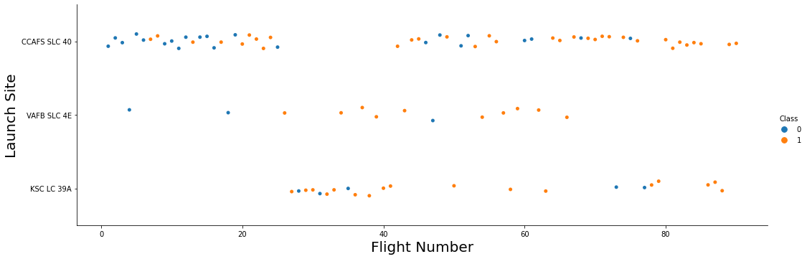
Flight Number vs. Launch Site
The above graph shows three takeaways:
The success rate increases with flight number overall
The success rate is the higher for KSC LC 39A and VAFB SLC 4E than CCAFS SLC 40
Most launches happen from CCAFS SLC 40 with a break in the middle

Slide 14
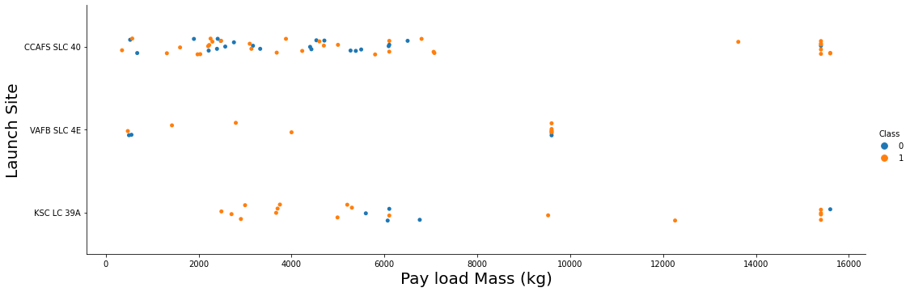
Payload vs. Launch Site
The payload varies for each flight and the maximum payload is different for each launch site (VAFB SLC 4E w/ ~950 kg vs CCAFS SLC 40 and KSC LC 39A w/ ~1550 kg)

Slide 15
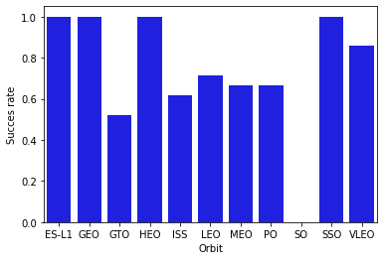
Success Rate vs. Orbit Type
Some orbit types have higher success rates than others:
ES-L1, GEO, HEO and SSO all have a 100% success rate

Slide 16
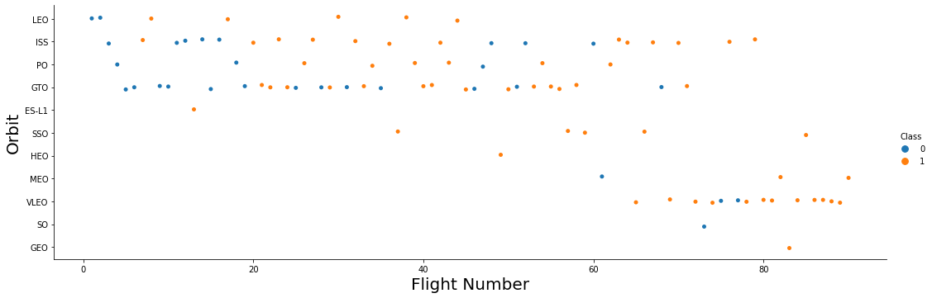
Flight Number vs. Orbit Type
Over time the type of mission has be changed from LEO/ISS/PO/GTO orbits to HEO/MEO/VLEO orbits
There is a positive correlation between success rate of the LEO orbit and flight number, but no such relationship exists for GTO – i.e. LEO launches get better over time but GTO launches do not

Slide 17
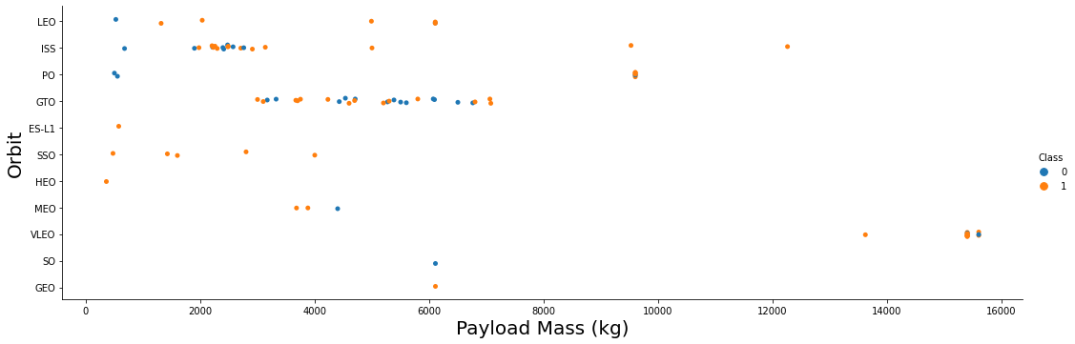
Payload vs. Orbit Type
With heavy payloads the successful landing rates are more for Polar, LEO and ISS.
However for GTO we cannot distinguish this as both succesful- and unsuccessful missions are both there here.

Slide 18
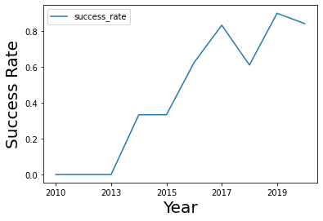
Launch Success Yearly Trend
It is seen that there exists an overall trend that the success rate of the launches increase year by year

Slide 19
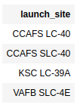
All Launch Site Names
Find the names of the unique launch sites
The SQL query to find these are:
SELECT DISTINCT(LAUNCH_SITE) FROM SPACEXTBL;
See output of the query on the right

Slide 20
Launch Site Names Begin with 'CCA'
Find 5 records where launch sites begin with `CCA`
The SQL query to find these are:
SELECT * FROM SPACEXTBL WHERE LAUNCH_SITE LIKE 'CCA%' LIMIT 5;
See output of the query on the next slide

Slide 21
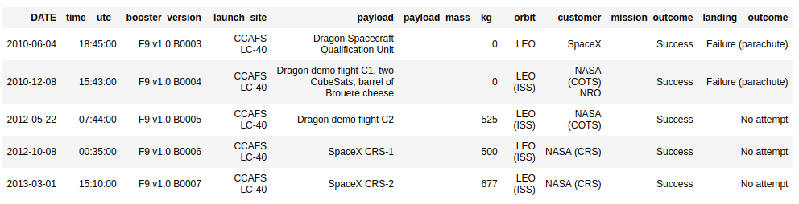
Launch Site Names Begin with 'CCA'

Slide 22
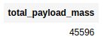
Total Payload Mass
Calculate the total payload carried by boosters from NASA
The SQL query to find these are:
SELECT SUM(PAYLOAD_MASS__KG_) AS TOTAL_PAYLOAD_MASS FROM SPACEXTBL WHERE CUSTOMER = 'NASA (CRS)';
See output of the query on the right

Slide 23
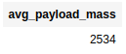
Average Payload Mass by F9 v1.1
Calculate the average payload mass carried by booster version F9 v1.1
The SQL query to find these are:
SELECT AVG(PAYLOAD_MASS__KG_) AS AVG_PAYLOAD_MASS FROM SPACEXTBL WHERE BOOSTER_VERSION LIKE '%F9 v1.1%';
See output of the query on the right

Slide 24
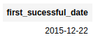
First Successful Ground Landing Date
Find the dates of the first successful landing outcome on ground pad
The SQL query to find these are:
SELECT MIN(DATE) as FIRST_SUCESSFUL_DATE FROM SPACEXTBL WHERE LANDING__OUTCOME = 'Success (ground pad)';
See output of the query on the right

Slide 25
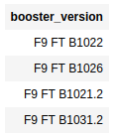
Successful Drone Ship Landing with Payload between 4000 and 6000
List the names of boosters which have successfully landed on drone ship and had payload mass greater than 4000 but less than 6000
The SQL query to find these are:
SELECT BOOSTER_VERSION FROM SPACEXTBL WHERE LANDING__OUTCOME = 'Success (drone ship)' AND PAYLOAD_MASS__KG_ BETWEEN 4000 AND 6000;
See output of the query on the right

Slide 26
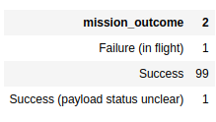
Total Number of Successful and Failure Mission Outcomes
Calculate the total number of successful and failure mission outcomes
The SQL query to find these are:
SELECT MISSION_OUTCOME, COUNT(*) FROM SPACEXTBL GROUP BY MISSION_OUTCOME;
See output of the query on the right

Slide 27
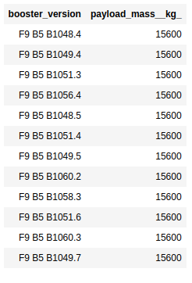
Boosters Carried Maximum Payload
List the names of the booster which have carried the maximum payload mass
The SQL query to find these are:
SELECT BOOSTER_VERSION, PAYLOAD_MASS__KG_ FROM SPACEXTBL WHERE PAYLOAD_MASS__KG_ = (SELECT MAX(PAYLOAD_MASS__KG_) FROM SPACEXTBL);
See output of the query on the right

Slide 28
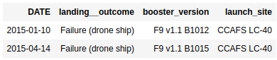
2015 Launch Records
List the failed landing_outcomes in drone ship, their booster versions, and launch site names for in year 2015
The SQL query to find these are:
SELECT DATE, LANDING__OUTCOME, BOOSTER_VERSION, LAUNCH_SITE FROM SPACEXTBL WHERE LANDING__OUTCOME = 'Failure (drone ship)' AND YEAR(DATE) = 2015;
See output of the query on the right

Slide 29
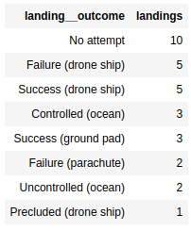
Rank Landing Outcomes Between 2010-06-04 and 2017-03-20
Rank the count of landing outcomes (such as Failure (drone ship) or Success (ground pad)) between the date 2010-06-04 and 2017-03-20, in descending order
The SQL query to find these are:
SELECT LANDING__OUTCOME, COUNT(*) AS LANDINGS FROM SPACEXTBL WHERE DATE BETWEEN '2010-06-04' AND '2017-03-20' GROUP BY LANDING__OUTCOME ORDER BY LANDINGS DESC;
See output of the query on the right

Slide 30


Slide 31
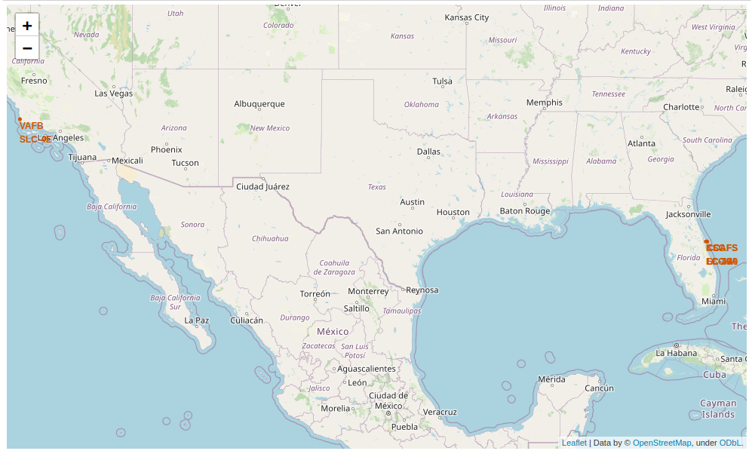
Launch Site Locations

Slide 32
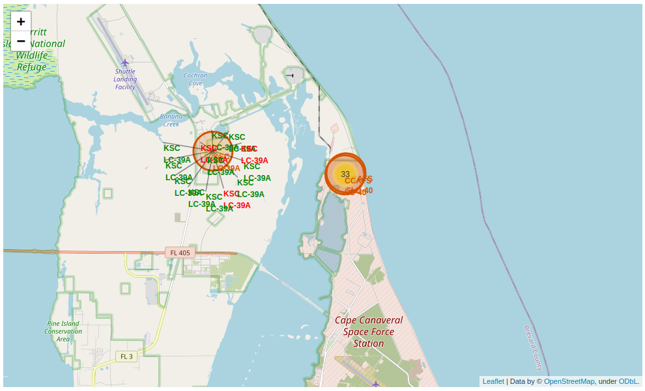
Map with Launch Outcomes at Each Site (example)

Slide 33
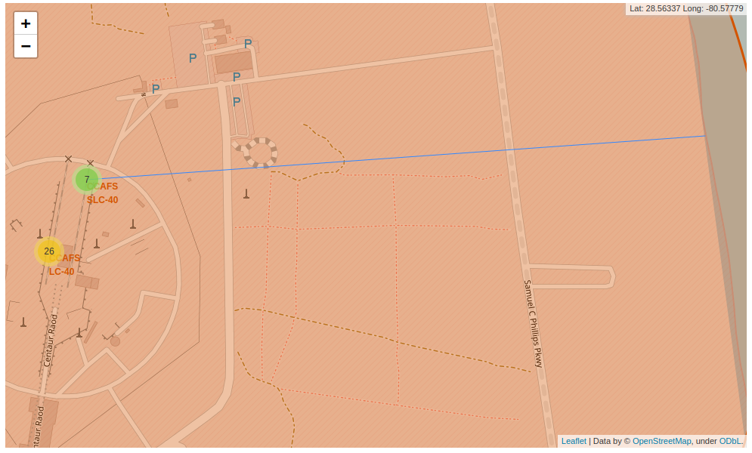
Proximity to Coastline

Slide 34


Slide 35
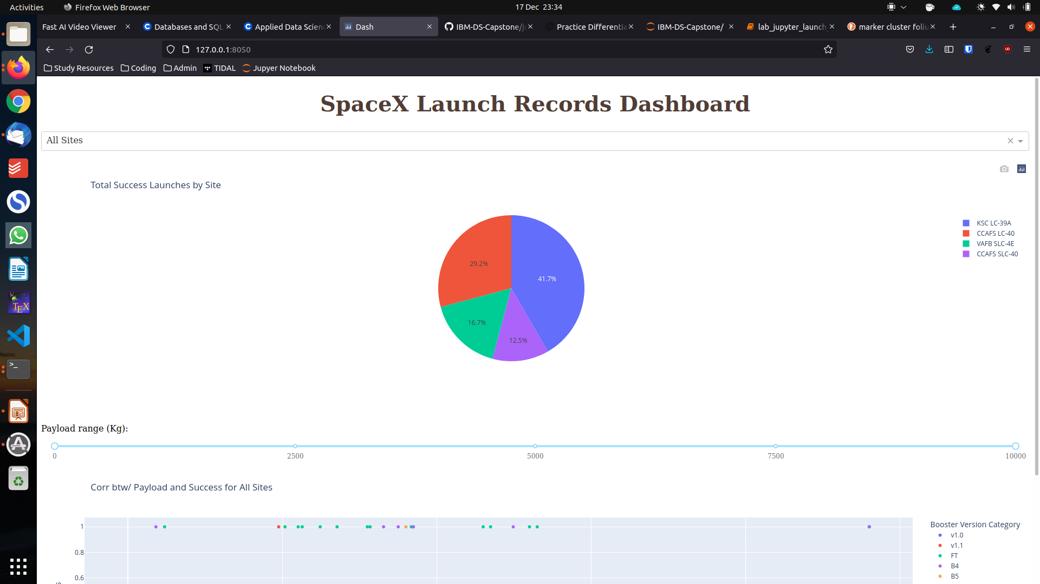
Launch success for all sites

Slide 36
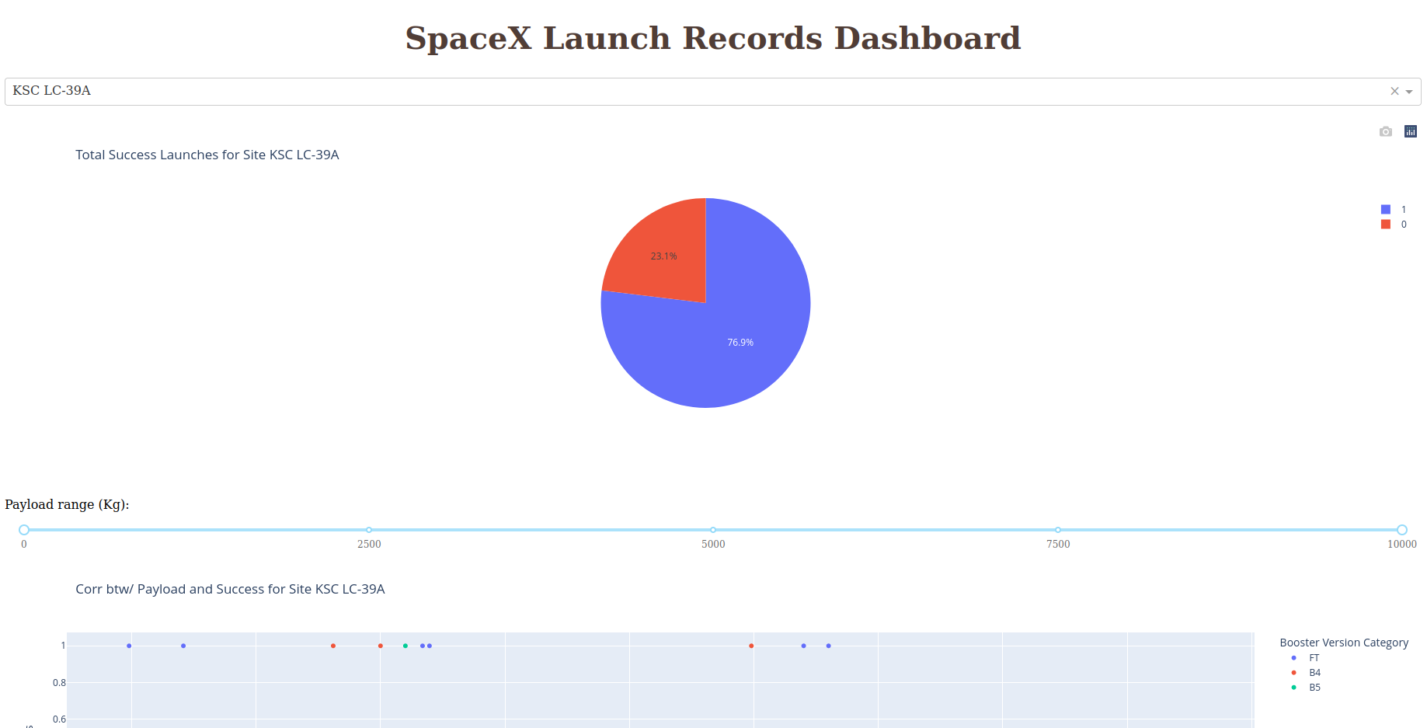
Launch Site with Highest Success Ratio

Slide 37
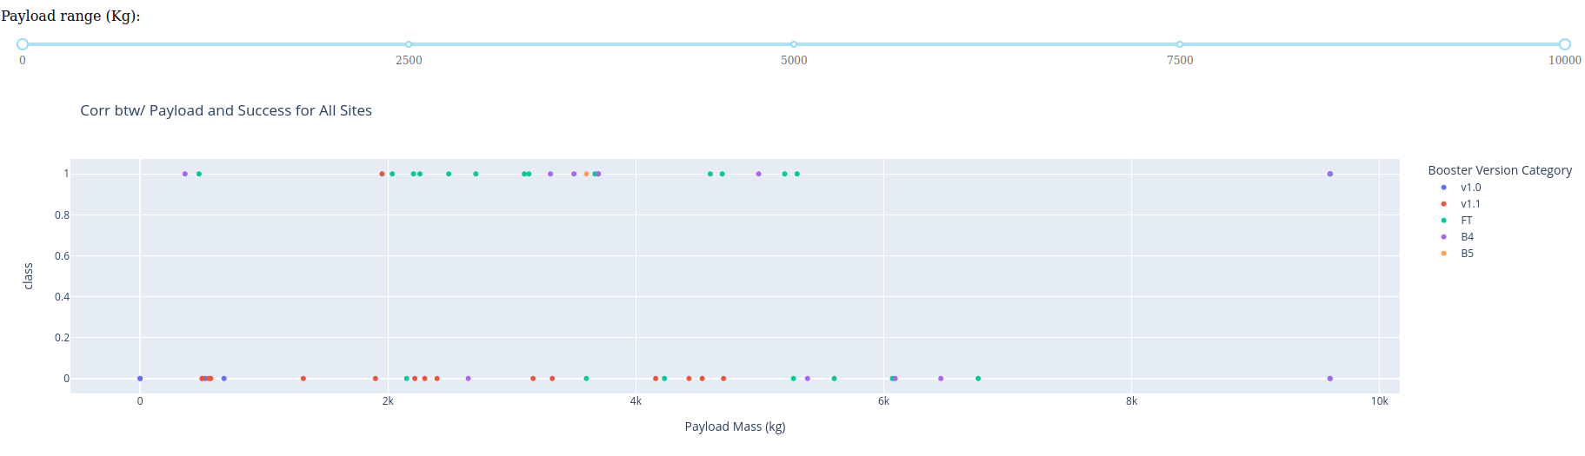
Payload vs Launch Outcome for All Sites

Slide 38


Slide 39
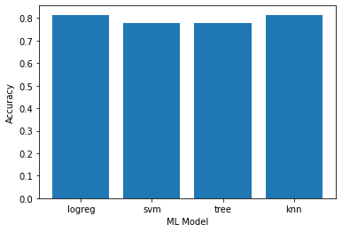
Classification Accuracy
The most acurate nodel is the KNN

Slide 40
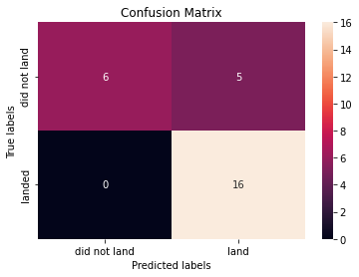
Confusion Matrix

Slide 41


